Slide 1
A large-scale and high-quality dataset for analyzing research contributions in NLP/ML/AI
INFO 5731 Section 020 - Computational Methods for Information Systems
(12/11/2023)
Mentor: Haihua Chen
Group-3
Team Member
Manasa Cherukupally (11604712)
Yamini Ravala (11582419)
Shyam Sundar Domakonda (11551019)
Sujit Murahari Giridharan (11589051)
Soumya Nanditha Chadalavada (11592124)
Sowmya Ushake (11602015)

Slide 2
Content:
Introduction
Background
Related Work
Methodology
Experiments and results
Discussion and implication
References

Slide 3

INTRODUCTION
Researchers mainly focus on keyword extractions, citations, and other structural analyses.
Research Contributions are Often overlooked
Research Contributions are novel features and outcomes of the research paper that aid in the understanding and advancement of its respective field, as well as significant aspects of the research paper that explain its methodology and approach.
Analyzing the research contributions will help in understanding the paper.

Slide 4
BACKGROUND
Earlier evaluation of the research activities focused on the frequency of the keywords, citation counts, and structural analysis.
The distinctiveness of these contributions lies in the incorporation of novel knowledge, methodologies, technologies, or insights that were previously unavailable or inadequately explored.
The contributions are a combination of New Findings, Theoretical Insights, Critical Analysis..
contributions add value to the academic community and may influence future research, shaping the direction of the field.

Slide 5
BACKGROUND
Challenges of Contribution Sentences Classification
The amount of data in these conferences is very large which makes it difficult to clean or perform web scraping in some conditions.
During the extraction it was difficult to get all the details regarding authors, their contributions and the year of their publication because of the large amount of input data in the conferences.
Some of the conferences blocked the IP addresses of the network which made reading the data tough and code had runtime errors.

Slide 6
BACKGROUND
Research Objects
To collect the Research papers and author details from the conferences related to NLP/ML/AI provided using Python web scraping.
Extract the contribution sentences using the rule-based method. Clean the extracted data.
Train the SCI- BERT model on data from the high-quality contributions dataset.
Use GPT-2 to train and Evaluate the model and predict the contributions.
Create high-quality data which is classified into 6 different contribution categories which are
1. Algorithms/ Methods Construction or Optimization
2. Performance Evaluation 3. Model Construction or Optimization
4. Data Creation or Resources 5. Applications
6. Theory Proposal

Slide 7
Related Work
Presenting MIND, a pivotal news recommendation dataset, revealing the crucial role of content understanding and user modeling, demonstrating NLP techniques' effectiveness for enhanced recommendation performance (Fangzhao Wu et al., 2020).
Enhancing NLP federated learning with FedID, address user data privacy concerns, rectify confirmation bias using server-retained labeled data, achieving superior results in homogeneous and heterogeneous scenarios (Xinge Ma et al., 2021).
Fine-grained annotation scheme with six categories for research contributions, SCI-BERT outperforms classic ML models, dataset publicly available (Chen et al., 2022).
Introducing CSL, a pioneering Chinese Scientific Literature dataset, address the gap in Chinese scientific NLP. It serves as a crucial resource and benchmark for tasks like summarization, keyword generation, and text classification (Yudong Li et al., 2022)
Scientific literature novelty framework contribution sentence analysis, deep learning models, and cloud similarity algorithm outperform semantic novelty measurement on ICLR dataset (Wang et al., 2023).

Slide 8
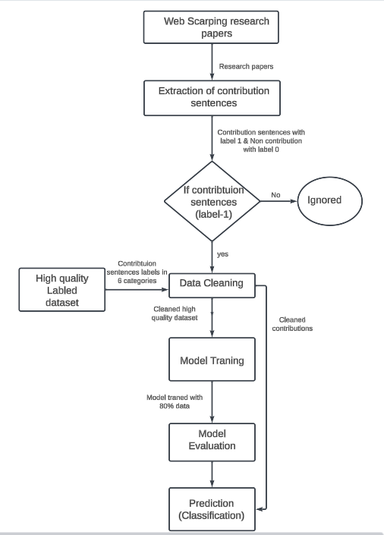
Methodology
Flow chart showing the steps followed
for the contributions classification

Slide 9
Methodology
Web Scraping
CoNLL- Conference on Computational Natural Language Learning
EmNLP-Empirical Methods in Natural Language Processing
JMLR- Journal of Machine Learning Research
extracted Conference papers From 2013-2023
Python Package Beautifulsoup is used
requests library to make an HTTP request to the provided URL
pdf_file.write to write data from link to file

Slide 10
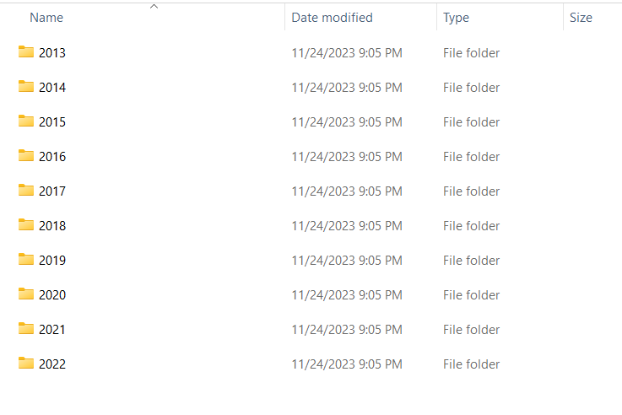
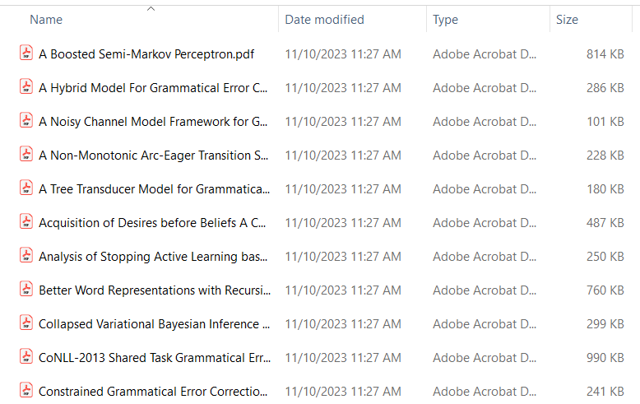
Research Papers

Slide 11
Methodology
Extracting Contributions
Rule-based method is used
Keyword Matching
Pronoun + Verb
pronouns = ['we', 'this paper', 'in this paper', 'i', 'the authors', 'our', 'the study', 'the research']
verbs = ['propose', 'contribute', 'introduce', 'describe', 'present', 'report', 'discuss', 'employ', 'study', 'explore', 'aim', 'hypothesize', 'argue', 're-use', 'evaluate', 'compare', 'baseline', 'result', 'approach', 'method', 'extend', 'ensemble', 'transfer learning', 'architecture', 'neural method', 'translation systems', 'system development', 'domain adaptation', 'train', 'experiment']

Slide 12
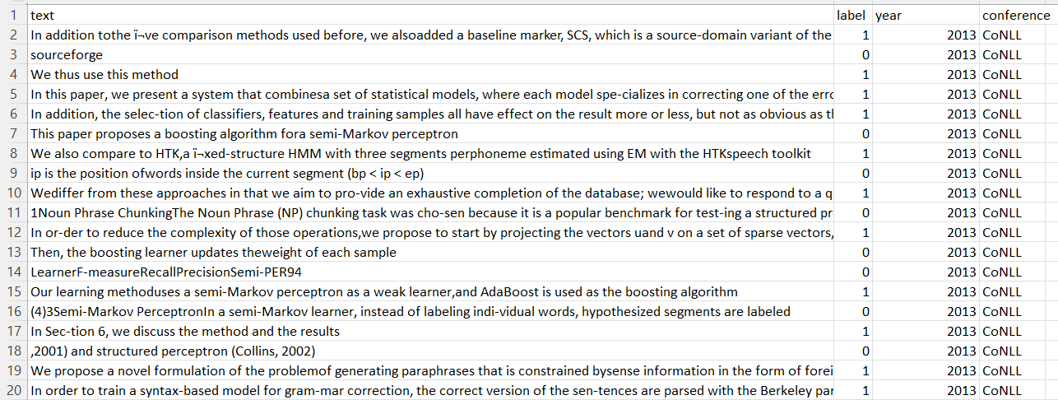
Sample Contributions and non Contributions

Slide 13
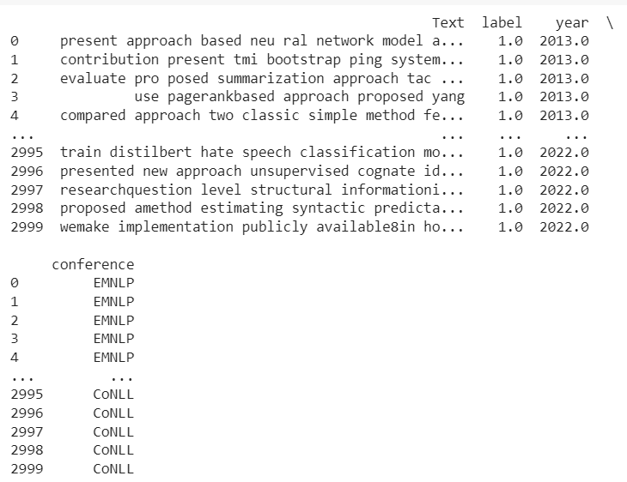
Methodology
Data Cleaning
Remove URLs, HTML, Tags, and Mentions
Remove punctuations and ASCII Characters
Lemmatization
Remove Stop Words
Exploratory Data Analysis
Word Count
Sentence count
Unigrams, Bigrams, Trigrams
POS-Tagging
TF-IDF
LDA Topic Modeling
BERTopic

Slide 14
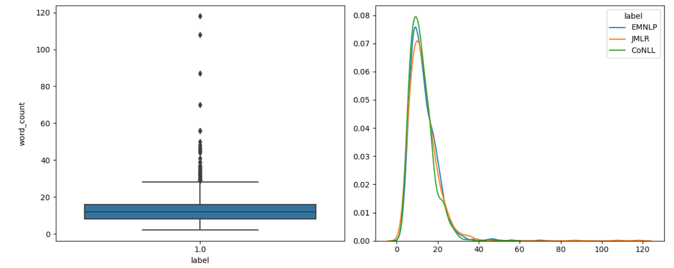
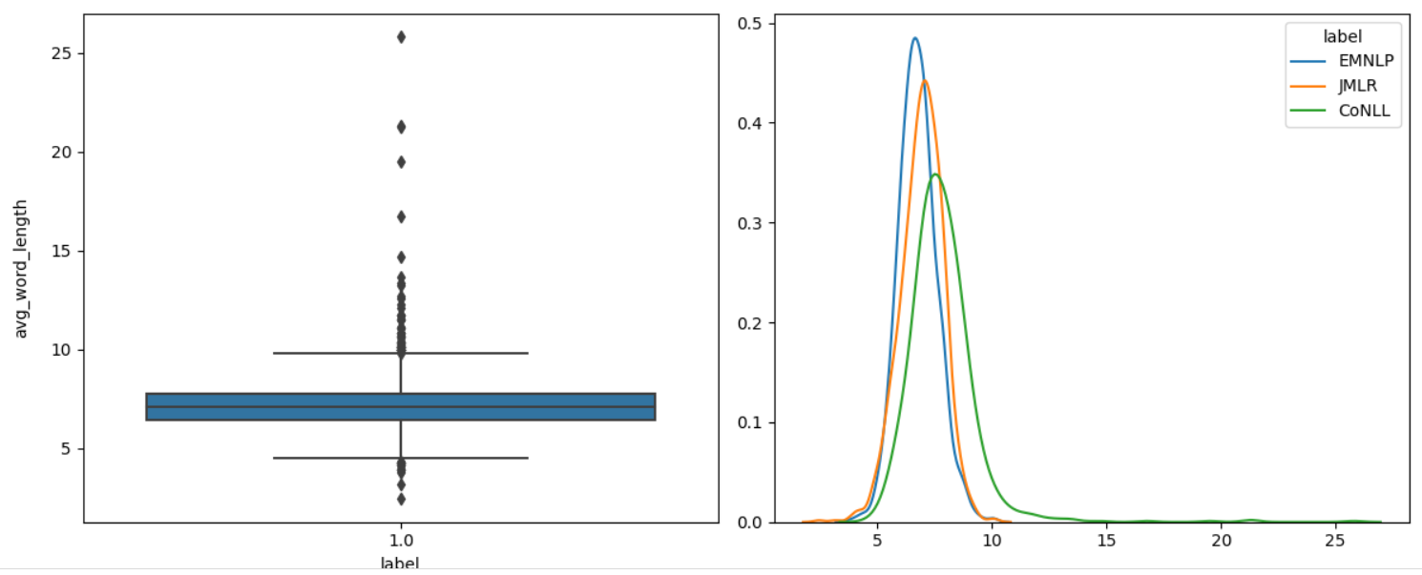
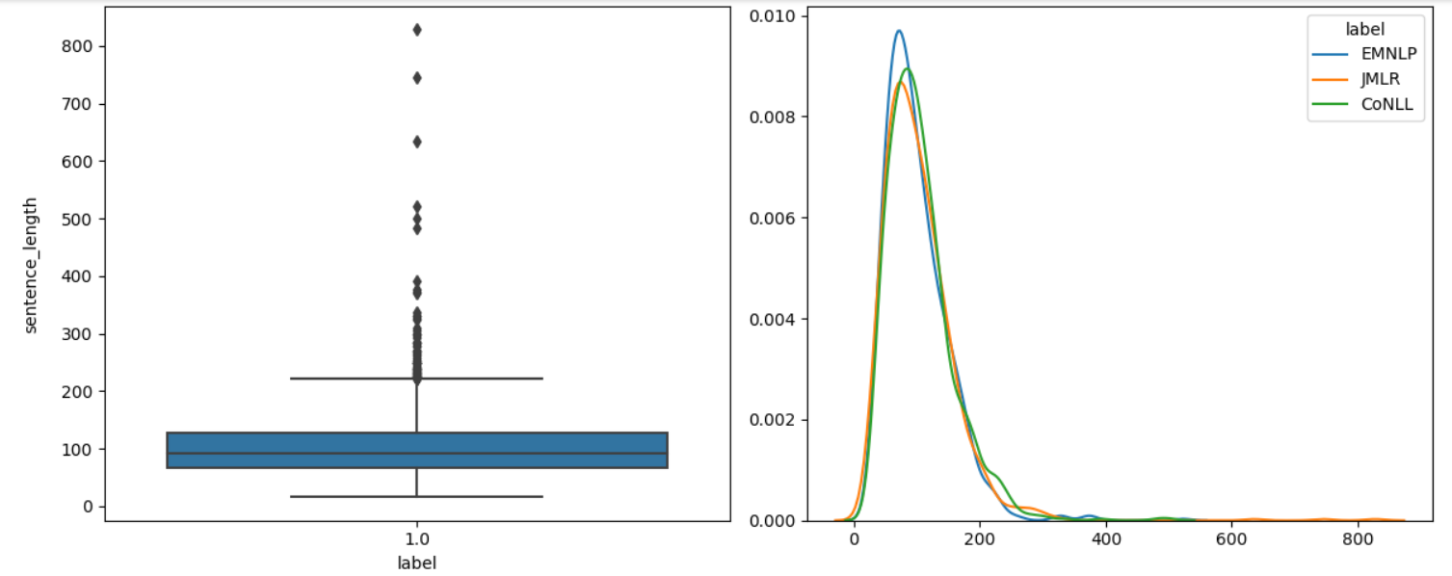
BOX PLOT

Slide 15
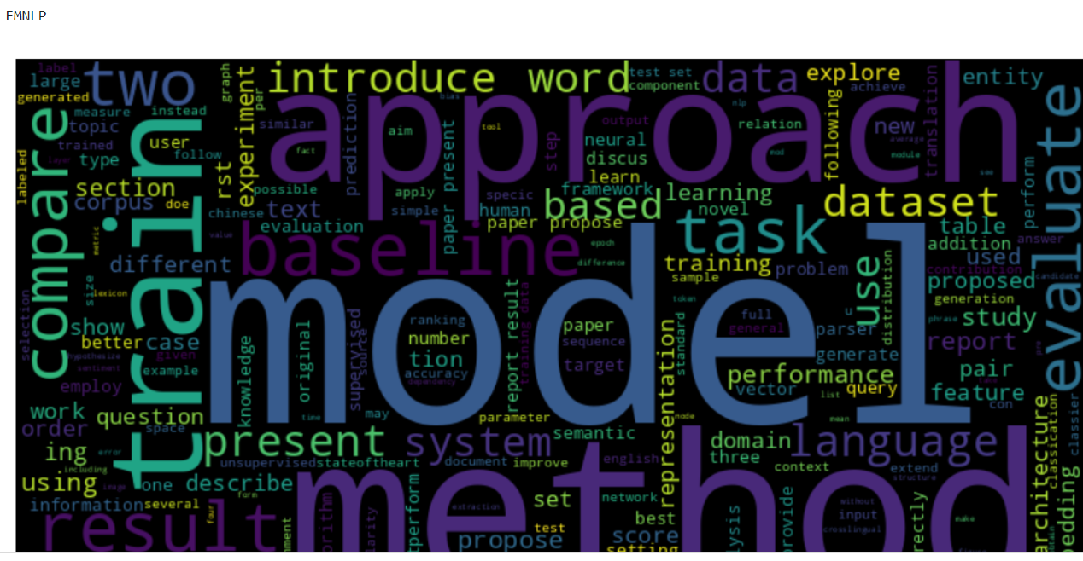
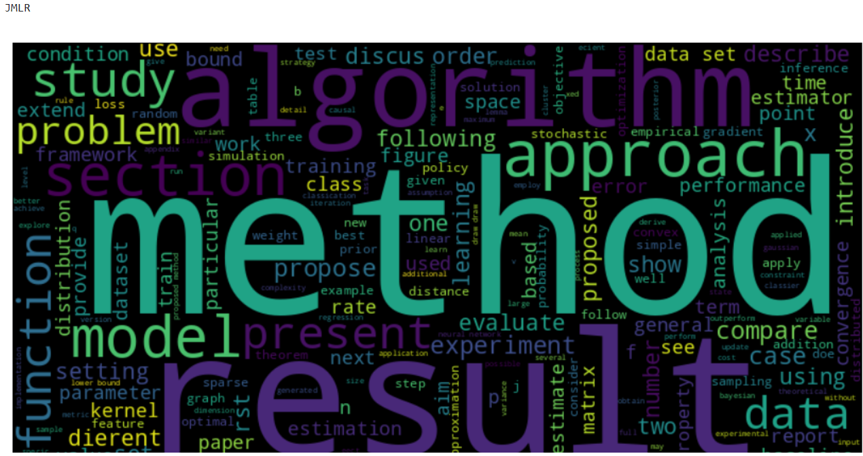
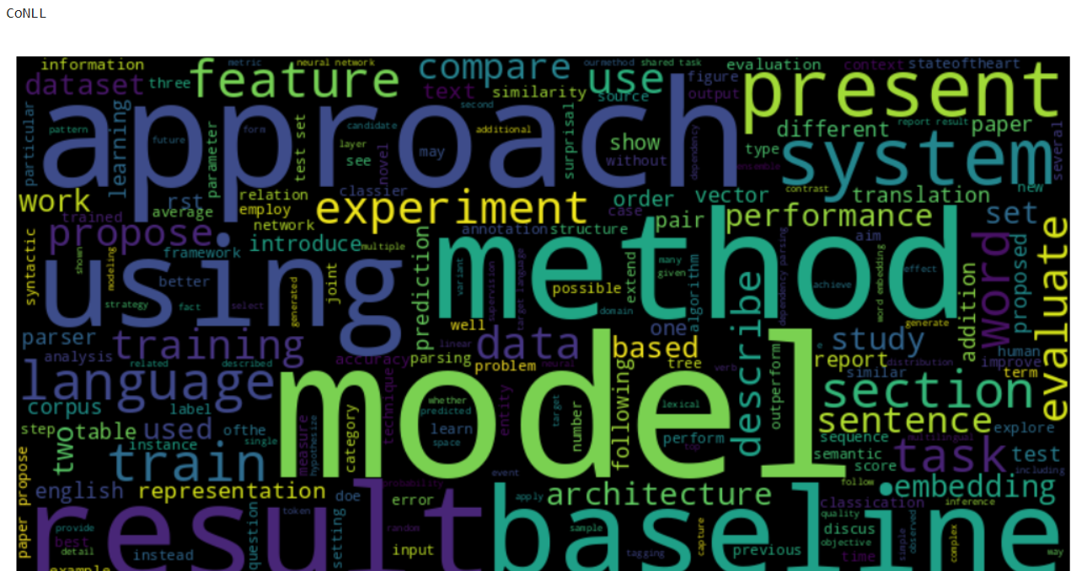
Word Cloud

Slide 16
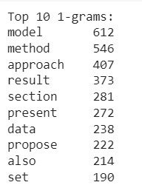
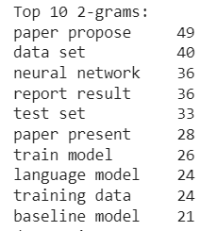
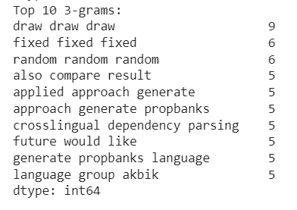
Unigram, Bigram, Trigram

Slide 17
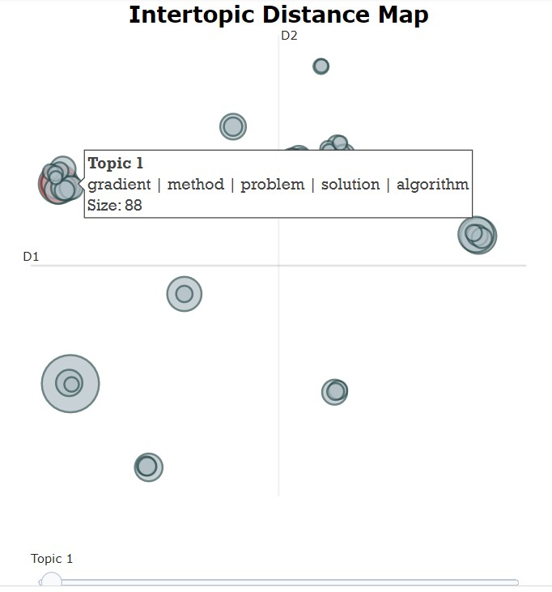
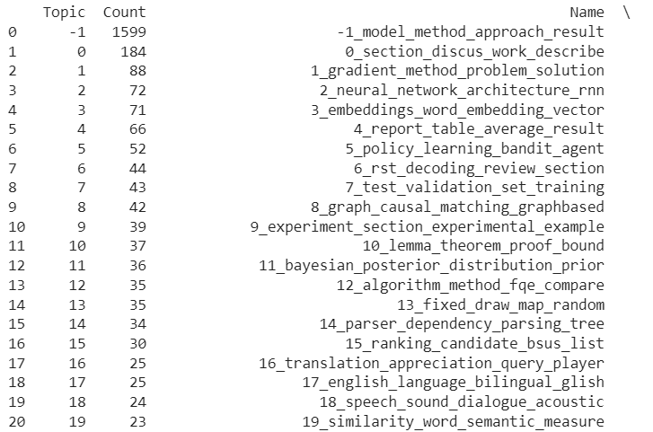
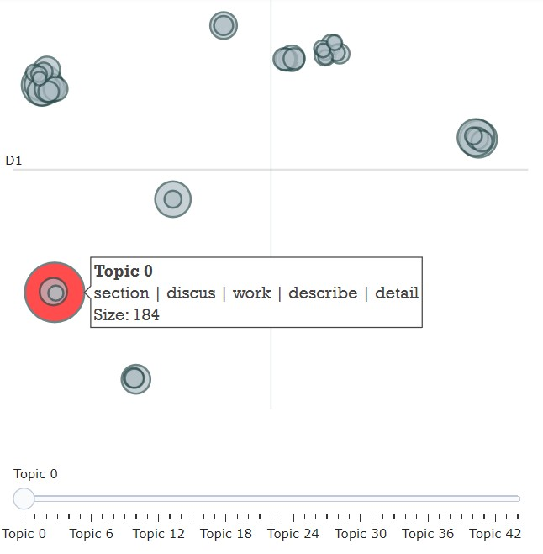
BERTopic

Slide 18
Methodology
Training the Model
SciBERT
GPT-2
Testing the Model
Extracted contributions are predicted using trained model

Slide 19
Experiments & Results
The dataset, primarily comprising NLP contributions, has been extensively cleaned and prepared, making it suitable for advanced text analysis.
The EDA reveals key trends and patterns in the dataset, such as the predominance of certain themes or topics over others.
Word frequency and n-grams analysis provide insights into the most discussed subjects and common linguistic patterns.
Topic modeling, through LDA and BERTopic, uncovers the main topics of discussion within the dataset, offering a deeper understanding of the content and focus areas in NLP contributions.

Slide 20
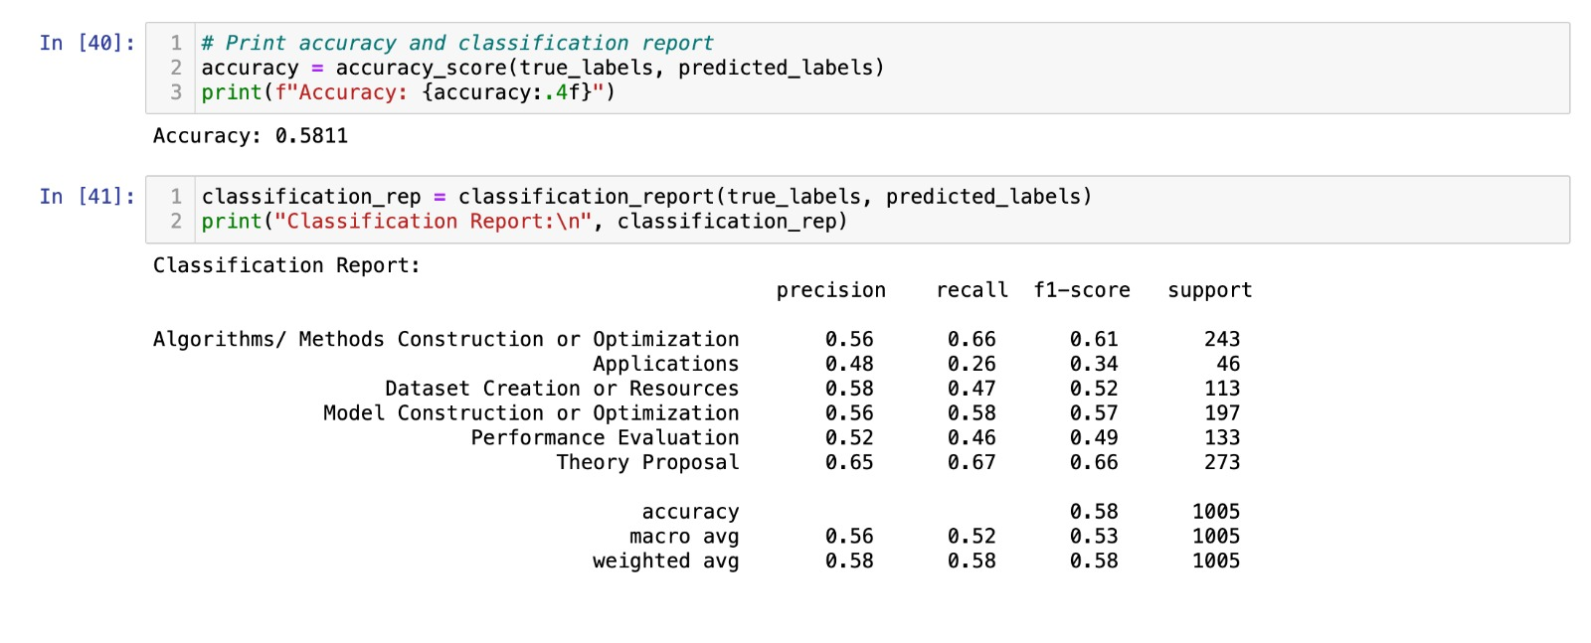
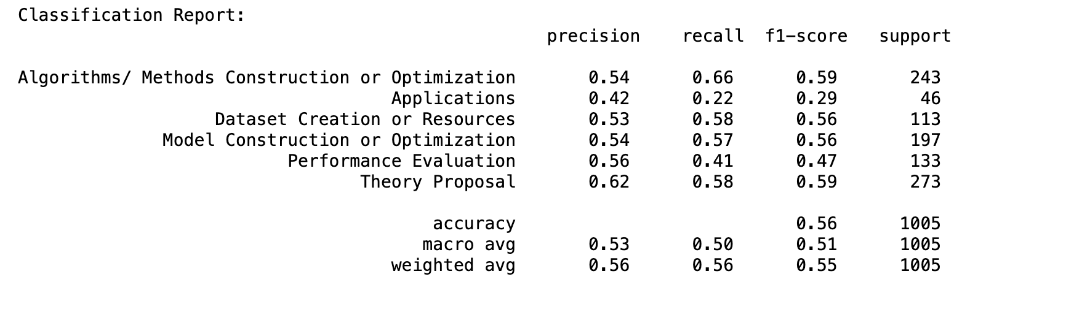
Overall results:
SciBERT Accuracy
Classification Report

Slide 21
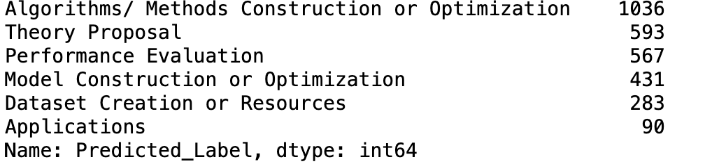
Overall Results
Category count(SciBERT):

Slide 22
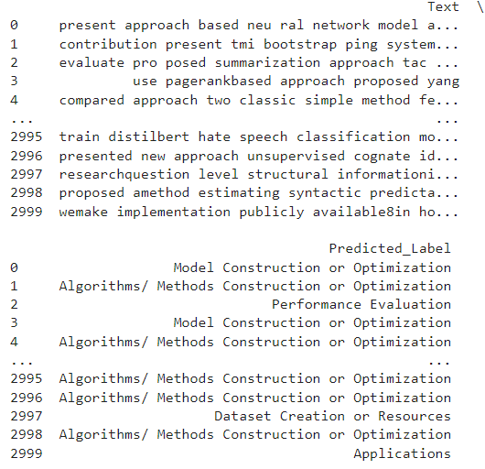
Overall Results
Predicted Labels using ScibERT

Slide 23
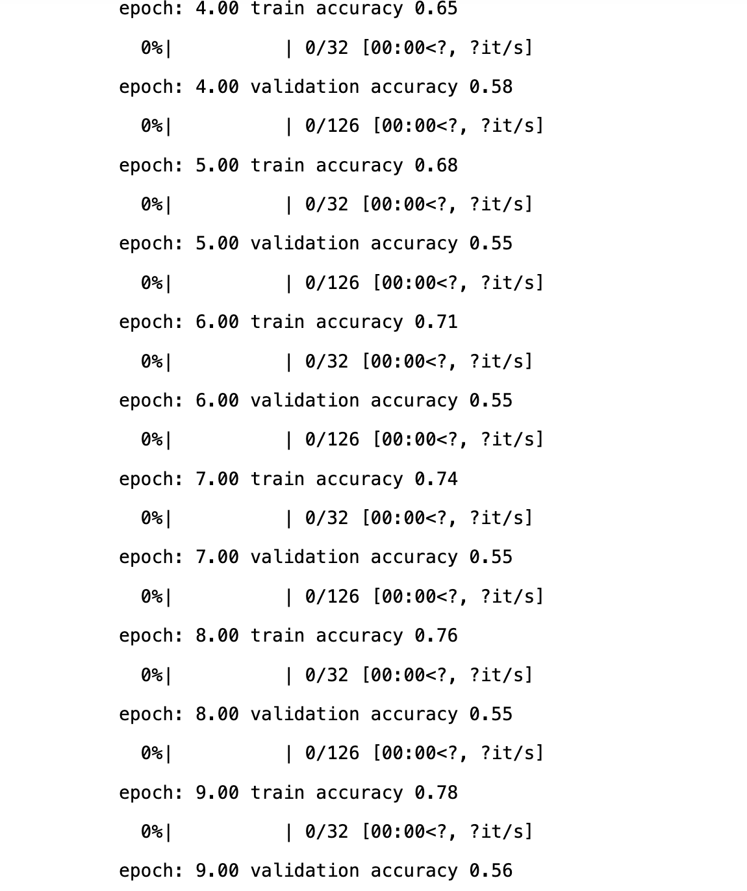
Overall Results
GPT-2 Accuracy

Slide 24
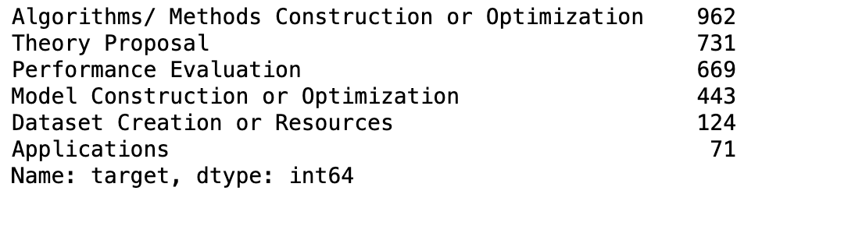
Overall Results
Category Count(GPT2):

Slide 25
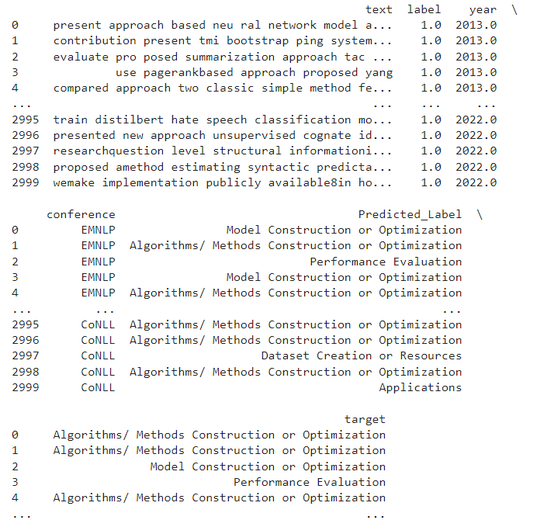
Overall Results
Predicted Labels using GPT-2 in the “target” column

Slide 26
Discussions
The retrieved contribution sentences were trained and tested using SciBERT and GPT-2 models, demonstrating the usage of cutting-edge machine learning methods.
SciBERT had an accuracy percentage of 58% and Chatgpt 2 had an accuracy of 56%.
It performed well in domains such as Theory Proposals and Algorithms/Methods Construction.Especially in these technical categories, SciBERT demonstrated exceptionally good in recall and precision.
Lemmatization, stop word removal, URL, HTML, tag, and mention removal were among the meticulous data cleaning procedures carried out. Word count, sentence count, n-grams, POS-tagging, TF-IDF, and topic modeling were all part of the exploratory data analysis process.
The language and organization of research contributions vary depending on their category.

Slide 27
Implications
The same performance of both models indicates that, although more generalized models like ChatGPT 2 can be extremely useful in academic text analysis, specialist models like SciBERT offer advantages as well. When choosing a model based on the data available, the requirement for specialization, and the intended scope of research, this could be important.
Our current focus involves constructing a comprehensive dataset intended to serve as a valuable asset for future research initiatives. The primary goal is to offer abundant data for analysis, facilitating the identification of emerging areas of interest and addressing gaps in current research.
In order to further increase accuracy and interpretability, future work may involve improving the SciBERT and chatGPT 3.5 models with Prompt Engineering that were utilized in the study. It may also involve investigating newer models that have been developed since the project's conclusion.

Slide 28
References
Chen, H., Nguyen, H., & Alghamdi, A. (2022). Constructing a high-quality dataset for automated creation of summaries of fundamental contributions of research articles. Scientometrics, 127(12), 7061-7075.
Wang, Z., Zhang, H., Chen, J., & Chen, H. Measuring the Novelty of Scientific Literature Through Contribution Sentence Analysis Using Deep Learning and Cloud Model. Available at SSRN 4360535.
Ma, X., Wang, J., & Zhang, X. (2021, August). YNU-HPCC at SemEval-2021 Task 11: Using a BERT Model to Extract Contributions from NLP Scholarly Articles. In Proceedings of the 15th International Workshop on Semantic Evaluation (SemEval-2021) (pp. 478-484).

Slide 29
Github Link
Project folder: https://github.com/ManasaCherukupally1/Manasa_INFO5731_Spring2023/tree/main/Group3-FinalProject
EDA and Prediction using SciBERT and GPT-2 https://github.com/ManasaCherukupally1/Manasa_INFO5731_Spring2023/blob/main/Group3-FinalProject/SciBERT_GPT2_final.ipynb

Slide 30
Author Contributions
Author | Contributions
Manasa Cherukupally | Involved in coding(Collection of research papers,extracting contributions, Data cleaning and model building GPT-2) Involved in making Presentation and Report
Yamini Ravala | Been part of extracting the data and data cleaning and also did model training. Contributed in making presentation and report.
Shyam Sundar Domakonda | Engaged in extracting data from conference papers, performing data preprocessing, and building SciBERT. Conducted hyperparameter tuning to enhance the performance of SciBERT. Involved to the creation of the presentation and report.
Sujit Murahari Giridharan | Extracted the data, involved in coding to extract data collection and contributed in making Presentation and report.
Soumya Nanditha Chadalavada | Been part of extracting the data and contributed in making Presentation and Report
Sowmya Ushake | I retrieved information, participated in coding to gather data, and contributed to the creation of both the presentation and the report.

Slide 31
Thank you

